Slide 1
Capstone – Open Pit Mining Supply Chain Analytics
By:-
Aishwarya Raj
Patibandla Manognya
Sindhu Balaga

Slide 2
Agenda
Objective
Background
Key Findings
Recommendations
Appendix :
Data methodology
Assumptions

Slide 3
Objective
Analyze key metrics related to production inefficiencies and develop an intelligent, real-time monitoring system.
Identify top-performing and underperforming equipment to optimize operational efficiency.
Assess and evaluate the payload capacity of equipment to ensure optimal usage.

Slide 4
Background
The client is experiencing significant inefficiencies in production, resulting in a loss of customer trust.
Despite stable demand, they are struggling to meet requirements effectively.
A real-time monitoring system is required to track production performance and address these challenges.

Slide 5
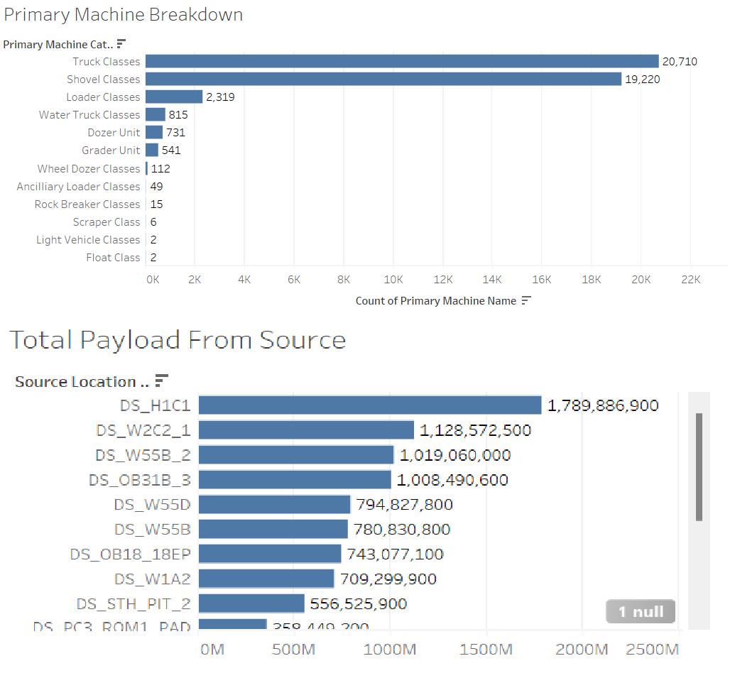
Key Findings Overview
A total of 126 machines are currently in operation across the mining sites.
The machinery is categorized into 12 distinct classes, including Dozer units, Grader units, and Shovel classes, among others.
Payload is extracted from 30 source locations and transported to over 69 designated destinations.

Slide 6
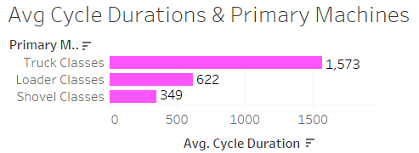
Key Findings Overview
Payload transportation is handled exclusively by the Loader, Shovel, and Truck classes.
Although Rock Breaker and Scraper classes exhibit significantly higher cycle times, the focus remains on the truck cycle, as only the Truck, Shovel, and Loader classes are involved in payload extraction and transport.
The average cycle time for the Truck class is 1,573 seconds, equivalent to 26 minutes.

Slide 7
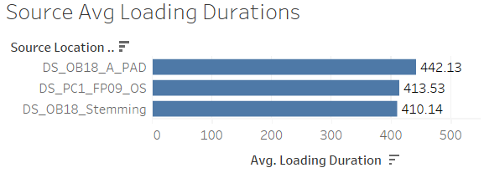
Key Findings Overview
The cycle duration encompasses the processes of digging ore, loading it onto trucks, transporting it to the crusher, and the subsequent return of the empty trucks to the source location.
The average loading time across the Loader, Truck, and Shovel classes is 183 seconds. Only the Truck class experiences a dumping duration, with an average of 44.7 seconds, as they travel between the digger and the crusher.
Certain locations exhibit notably high loading durations, exceeding 400 seconds.

Slide 8
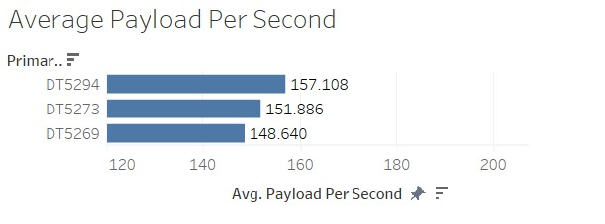
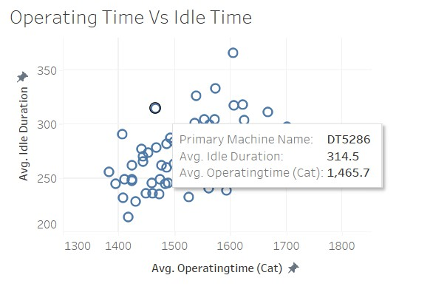
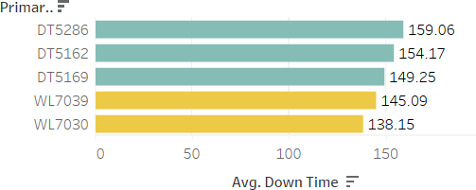
Key Findings - Worst Performing Equipment's
The trucks depicted in the chart on the right carry the lowest payloads.
The chart in the bottom-right illustrates the correlation between operating time and idle time.
The machines listed below exhibit the highest downtime.

Slide 9
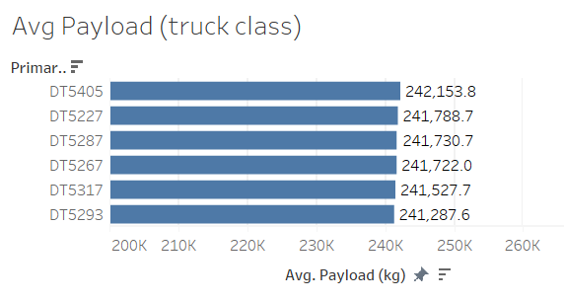
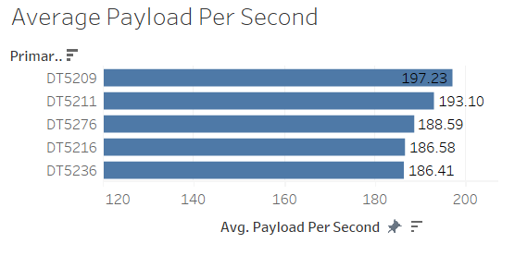
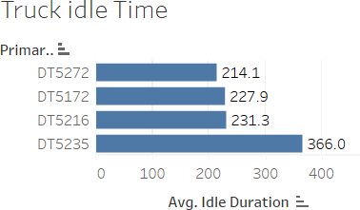
Key Findings - Top Performing
The trucks listed are those carrying the highest payload amounts.
These trucks also exhibit the highest payload efficiency, measured in payload per second or tons per hour.
Truck DT5235 has an idle time that exceeds the least average idle time by 152 seconds.

Slide 10
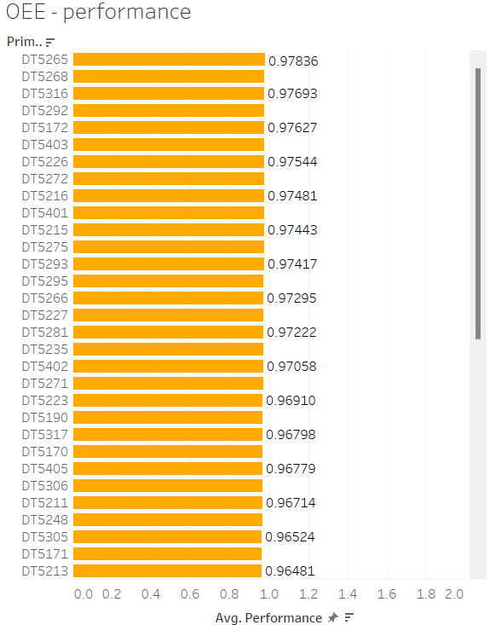
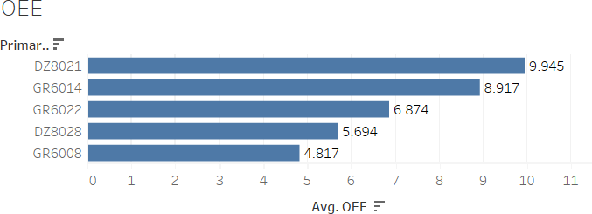
Key Findings - OEE
The Overall Equipment Effectiveness:
Availability
Performance
Quality
We get OEE by multiplying the 3 factors

Slide 11
Recommendations
Replace machines with an average downtime exceeding 149 seconds, specifically DT5286, DT5162, and DT5169.
Replace machines with an Overall Equipment Efficiency (OEE) below 0, particularly DZ8083 and GR6016.
Consider reallocating production resources and equipment from source locations with idle times exceeding 350 seconds to other locations to optimize efficiency.

Slide 12
Appendix
Data Methodology:
Data was cleaned using Jupyter Notebook, with further analysis conducted in MySQL Workbench 8.0, and visualizations created in Tableau Public.
Outliers were removed to ensure data accuracy and consistency.
The cleaned dataset consists of a total of 44,522 rows.
Stored procedures were created in MySQL for various data categories, including cycle data, location/movement data, delay data, and Overall Equipment Efficiency (OEE).
Calculated fields were generated in Tableau for key metrics, such as OEE, performance, and payload per second, where Payload per second is defined as Payload (kg) / Cycle Duration.

Slide 13
Appendix
Assumptions:
Net available time is calculated as the total available time in the mine minus idle time.
Net operating time is calculated as the operating time of equipment minus idle time.
Equipment with downtime is assumed to have undergone maintenance.

Slide 14
Thank you

